Slide 1

Real estate housing analysis
Team #1
Donal tamakuwala
Elena maksimova
Kajal mengar
Mandara kadya
Nadine blaik

Slide 2

Why is the youngest generation struggling to afford houses post pandemic ?
Our hypothesis leads us to believe that it might be due to the relationship between the interest rate and the housing prices.

Slide 3
Question
1-What is the impact of housing prices in home ownership with young adults ?
2--How are the different provinces responding to the interest rates in term of real estate activity and pricing
3- What are the alternative outlooks to buying a home?
4-What is the relationship/correlation between the interest rate fluctuations and inflation?
5- What are some of the information that we found to address the housing crisis in Canada ?

Slide 4
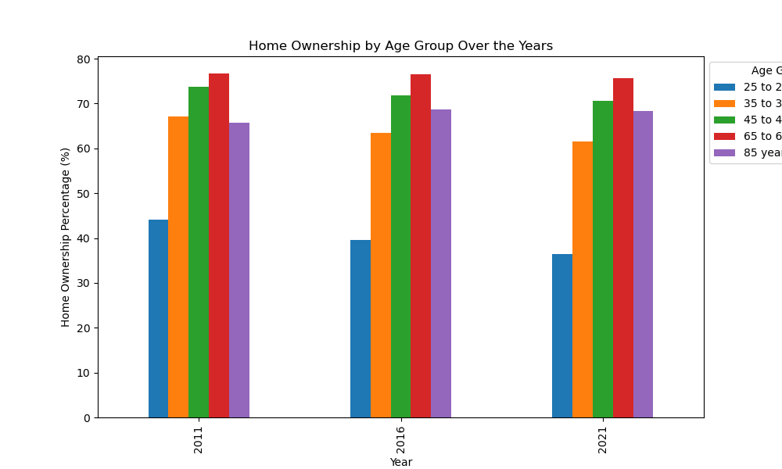

Slide 5
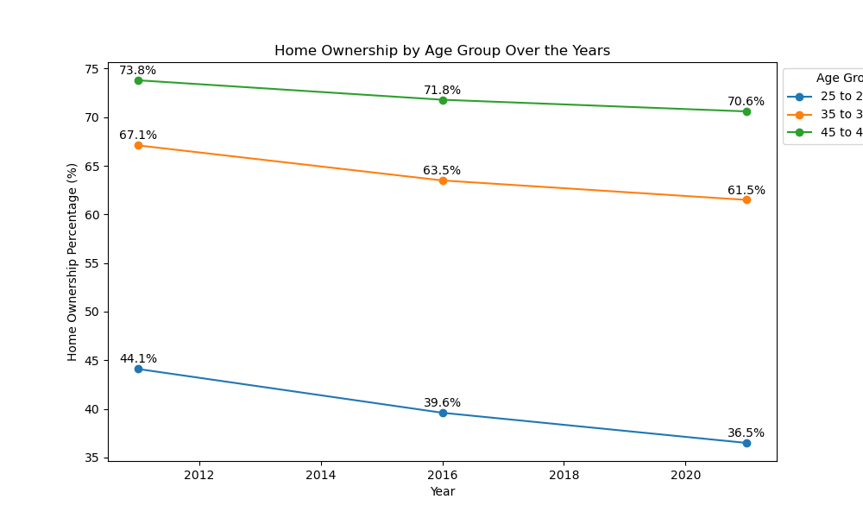

Slide 6
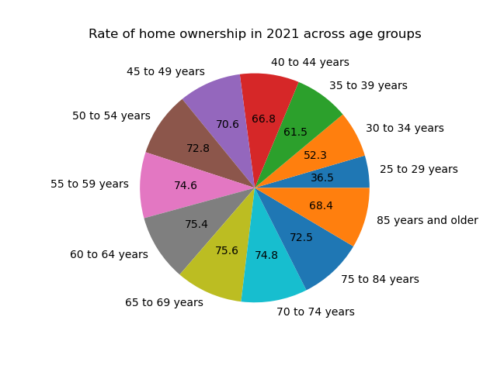

Slide 7

Conclusion
We noticed a trend where home ownership for the younger age group ( 25-29 years old) have declined over the years. This could be related to the job market, higher inflation and an increase in cost of life as well as lower wages for jobs. The interest rates would be a secondary cause to what first impacts the decision making that comes with buying a home. The older generations have been able to take advantage of better economic environment in the past which explains how high their home ownership percentage is.

Slide 8
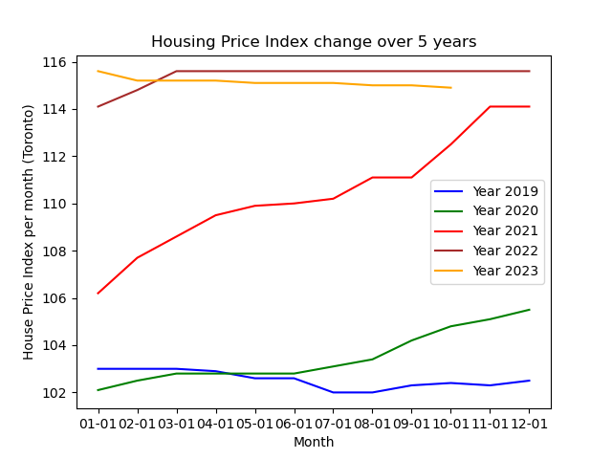

Slide 9
API link - https://api.nytimes.com/svc/search/v2/articlesearch.json?api-key=<>&q=canadian housing market

Slide 10
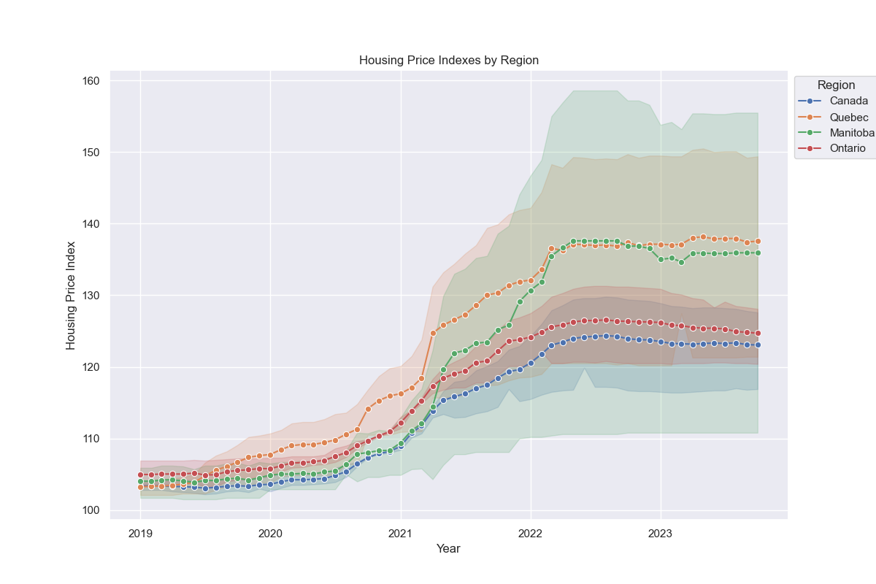

Slide 11
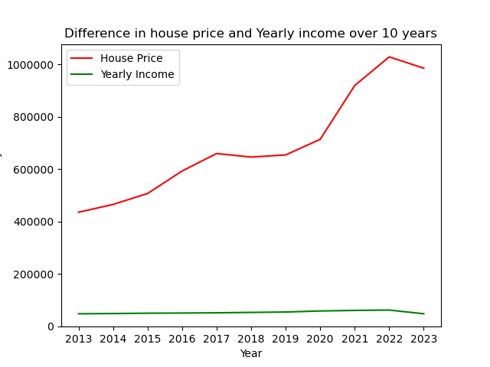

Slide 12

Conclusion
We can notice a significant increase in prices post pandemic. This is sustained by a higher demand and a lower supply of homes. With the interest rate playing a significant role in the buyer’s ability to afford a house. We can observe the higher increase in housing prices in the province of Quebec. Another major notable difference is how the yearly income has increased slightly while the house prices have been soaring.

Slide 13
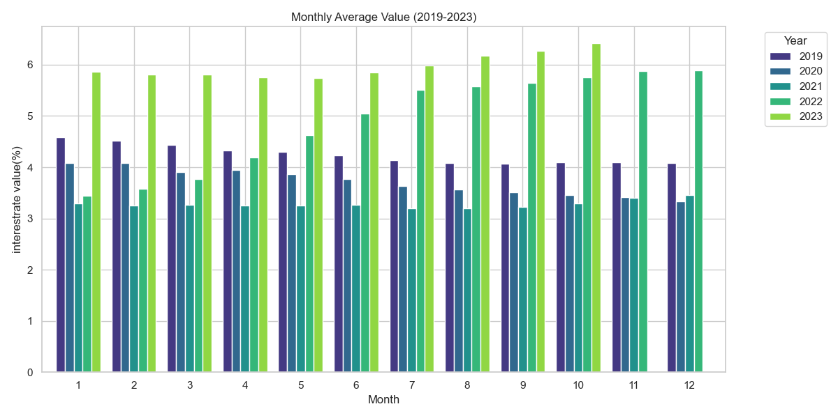

Slide 14
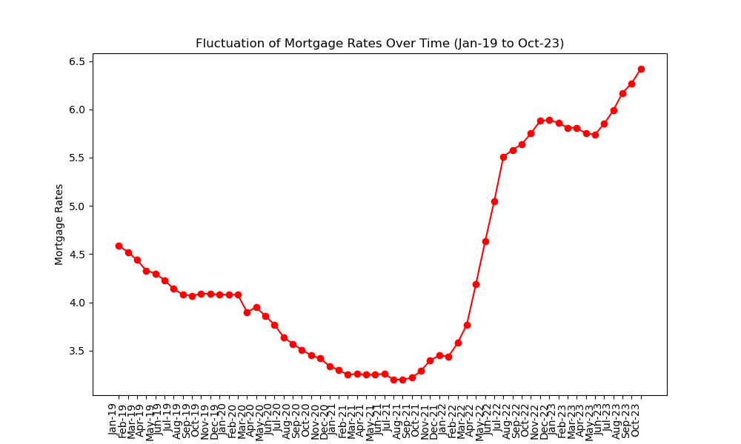

Slide 15
Conclusion

Slide 16
Conclusion

Slide 17

References
https://www150.statcan.gc.ca/n1/daily-quotidien/220921/cg-b002-eng.htm
House Price Index - https://www.kaggle.com/datasets/anki112279/canada-housing-price-data-by-regions-19812022
Mortgage Rate - https://open.canada.ca/data/en/dataset/ae607e9a-2fce-4ed9-83e3-ba4cdbc24b8d/resource/22c8bc22-2bd4-41b6-8da5-ee57672a1d5f
https://www.kaggle.com/datasets/anki112279/canada-housing-price-data-by-regions-19812022
https://www150.statcan.gc.ca/n1/daily-quotidien/220921/cg-b002-eng.htm
https://open.canada.ca/data/en/dataset/ae607e9a-2fce-4ed9-83e3-ba4cdbc24b8d/resource/22c8bc22-2bd4-41b6-8da5-ee57672a1d5f
https://www.crea.ca/housing-market-stats/mls-home-price-index/hpi-tool/
https://www150.statcan.gc.ca/t1/tbl1/en/cv.action?pid=1410022201

